Slide 1
Applied Data Science Capstone Final Project Presentation
Jonathan Kolb

Slide 2
Introduction/Business Problem
We have recently been hired by Kool Beanz, a coffee bean distributor who wants to open their own coffee shop in New York City. Kool Beanz is familiar with the classic economic problem of the Hot Dog Vendors: two vendors are sharing a beach, and they know that the visitors on the beach will visit the vendor that is closest, and that the visitors are evenly distributed across the beach. Even if the vendors initially start out equally spaced out from each other, they can get more customers by moving closer to their rival. As a result, each vendor moves closer and closer to the middle of the beach to get more customers until they're right next to each other. This problem is used to explain the paradoxical outcome of gas stations, fast food restaurants, and coffee shops being located very close to each other - sometimes across the street! As a result, Kool Beanz has decided that the best place to open a coffee shop is as close to as many other coffee shops as possible and has hired us to find these locations.

Slide 3
Introduction/Business Problem
To translate this task into a data science problem, we've been tasked with identifying the centroid of coffee shop clusters in New York City, so that our client can then choose where to build their new coffee shop.

Slide 4
Data
We will be using the geolocation data available from Foursquare to identify the location of coffee shops in New York City. Foursquare has the coordinates of venues, as well as a venue category that describes the location (Beer Bar, Italian Restaurant, Yoga Studio, etc.). While there is a specific 'Coffee Shop' category, we may want to also include other venues such as 'Cafes'. We will want to focus on just the coffee shop and similar venues with New York City itself, and not nearby locations like Yonkers.

Slide 5
Data
Because coffee shops are spread-out all-over New York City, simply finding the closest single point to all of them is going to give us a point very close to the geographical center of city and wouldn't be very helpful. Instead, we will try to split up the coffee shops into clusters, where we'll minimize the intra-cluster distance between coffee shops and maximize the inter-cluster difference. Unlike other cluster similarity questions we've addressed in this course, we will be looking at the literal distance.

Slide 6
Data
To achieve this, we will use K-Means Clustering to identify these centroids. We will also need to compare different values of K to determine how many clusters we should create, and therefore how many candidate locations we should provide our client.

Slide 7
Methodology
Because we are trying to cluster unlabeled data, we will be using the K-means model. The K-means model is an interative process where K centroids are moved to the center of their clusters and re-evaluated until a local optimum is reached. This, in theory, will be our candidate locations for our client to consider. I chose this model because it is simple, fast, and produces an intuitive result when trying to cluster unlabeled data.
Because we are dealing with the physical coordinates of venue locations, we avoid any complications with normalizing the data - we're only dealing with physical distance without any need to convert measurements. That leaves only two unanswered questions from the previous section:

Slide 8
Methodology
Should venues like coffee shops, such as cafes, be included in our analysis? As is often the case in data science, this question doesn't have an objective answer and instead relies upon our best judgment.
What value should we for K in our model? K determines the number of clusters in our model and is again a question of judgment. We will be using the Elbow Method to identify the point where adding additional clusters doesn't improve the model. Also, as our client's ability to consider different locations is limited and to avoid decision paralysis, we will be limiting K to a 'reasonable' number - no more than 20 candidates will be considered.

Slide 9
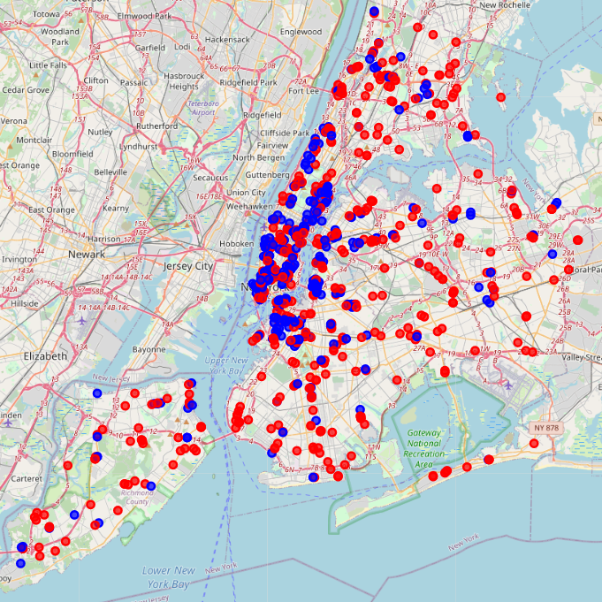
Question 1: Should we include Bagel Shops, Donut Shops, and Cafes?
The map to the left shows Coffee Shops (marked in blue) and other similar venues (marked in red), as physically distributed across New York City.
We can see a clear discrepancy between the distribution of the blue and red dots. Clearly, there is a difference of some sort between Coffee Shops and other venues that serve coffee.
As such, since we’re specifically interested in Coffee Shops, these other venues are not helpful to our analysis and will be excluded.

Slide 10
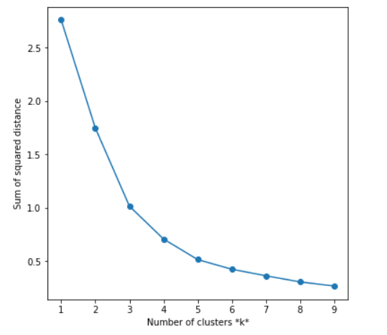
Question 2: How many clusters should we use; or, what value for K?
The graph on the left shows the sum of squared distance for K values 1 through 9. We use the Elbow Method to identify the best number of clusters
The result is ambiguous – arguments could be made for K values of 3, 4, or 5.
However, 5 seems like the best ‘joint’ to me, and what I ultimately choose to use.

Slide 11
Results
By using K=5, we find five clusters of coffee shops in New York City that can be generally described as follows:
Staten Island (Red)
Brooklyn (Yellow)
Queens (Orange)
Lower Manhattan (Green)
Upper Manhattan/The Bronx (Blue)
We've also identified 5 candidates for Kool Beanz to consider as their new coffee shop location, achieving the goals laid out for us.

Slide 12
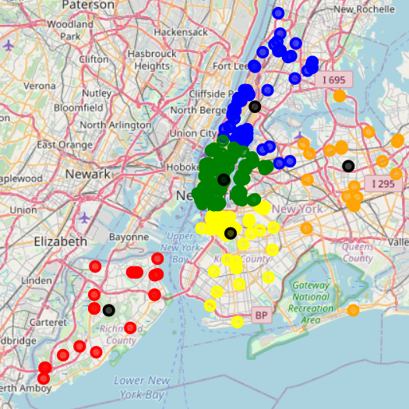
Staten Island (Red)
Brooklyn (Yellow)
Queens (Orange)
Lower Manhattan (Green)
Upper Manhattan/The Bronx (Blue)
Centroids are marked in black

Slide 13
Discussion
However, there is some space for further discussion and analysis. We can see visually that coffee shops are not evenly distributed across New York City. We can also see that there is some sort of difference between a Coffee Shop and the other categories we considered but ultimately rejected. While we can't articulate what that difference is, the geographical disparity obviously indicates that difference exists and is important to our analysis. We may want to investigate this difference more deeply; in case it has some implications for our client.

Slide 14
Discussion
Next point, we have achieved our goal and identified 5 candidates, but there are few obvious issues. First, the Staten Island and Queens clusters, while intuitively grouped together, have significant distance between the points and the centroid isn't particularly close to many of the other coffee shops. Really, only the Brooklyn and Lower Manhattan centroids seem to visually match our goal. This indicates that the K-means model isn't exactly the right tool for our purposes - we're not interested in just identifying clusters, but also interested in the density as a factor. We may want to consider different tools for this job and not just our judgment and visual inspection.

Slide 15
Conclusion
In conclusion, while there is additional work that could be done, we've achieved our goals and have something ready to show our client. If this was a real-world situation, we'd have to consider whether the perfect is the enemy of the good, versus there was enough time and resources available to provide the best quality analysis possible. I would certainly want to spend more time on the issue investigating density as a mathematical construct and follow up on the Coffee Shop/Donut Shop dichotomy, but sometimes you don't have that opportunity.
Overall, I am pleased with my results and the new skills that I've learned.

